Slide 1
E/M codes

Slide 2
Three factors of E/M codes
Three factors of E/M codes Code assignment in the E/M section varies accordiing to three factors:
Place of service
Type of service
Patient status

Slide 3
Place of service
Place of service explains the setting in which the services were provided to the patient. Codes vary depending on the place of the service. Places of service can be a physician’s office, hospital, emergency department, nursing home, and so on.

Slide 4
Type of service
Type of service is the reason the service is requested or performed. Examples of types of service are consultation, admission, newborn care, and office visit.
Consultation is a written or verbal request from one provider/physician to another to obtain an opinion and/or advice about a diagnosis or management options.
Admission is attention to an acute illness or injury that results in admission to a hospital.
Newborn care is the evaluation and determination of care management of a newly born infant.
Office visit is a face-to-face encounter between a physician and a patient to allow for primary management of the patient’s health care status

Slide 5
Patient status
The four types of patient status are new patient, established patient, outpatient, and inpatient.
New patient is one who has not received professional services from the physician or another physician of the exact same specialty and subspecialty in the same group within the past 3 years.
Established patient is one who has received professional services from the physician or another physician of the exact same specialty and subspecialty in the same group within the past 3 years.
Outpatient is one who has not been formally admitted to a health care facility or a patient admitted for observation.
Inpatient is one who has been formally admitted to a health care facility.

Slide 6
Office, new patient
According to the E/M Guidelines, the following categories/subcategories must meet or exceed the stated level of the key components:
Office or Other Outpatient Services, New Patient
Initial Observation Care, New or Established Patient
Initial Hospital Care, New or Established Patient
Office or Other Outpatient Consultations, New or Established Patient
Observation or Inpatient Care Services, New or Established Patient
Inpatient Consultations, New or Established Patient
Emergency Department Services, New or Established Patient
Initial Nursing Facility Care, New or Established Patient
Domiciliary, Rest Home (e.g., Boarding Home), or Custodial Care Services, New Patient
Home Services, New Patient

Slide 7
Key components
The key components of history, examination, and medical decision making reflect the clinical information that is recorded by the physician in the patient’s medical record. Key components are present in every patient case except counseling encounters
New patient encounters, consultations, emergency department visits, and admissions require documentation of all three of the key components. Subsequent visits such as daily hospital visits or outpatient visits for an established patient require that only two of the three key components be present for assignment to a given code
History
Examination
Medical decision making

Slide 8
History
The history is the subjective information the patient tells the physician based on the four elements of a history
Chief complaint (CC)
History of present illness (HPI)
Review of systems (ROS)
Past, family, and social history (PFSH). The history contains the information the physician needs to appropriately assess the patient’s condition.

Slide 9
History
Chief Complaint (CC)
Chief Complaint (CC) is a concise statement describing the symptom, problem, condition, diagnosis, physician-recommended return, or other factor that is the reason for the encounter, usually stated in the patient’s words.
History of Present Illness (HPI)
History of Present Illness (HPI) is a chronological description of the development of the patient’s present illness from the first sign and/or symptom or from the previous encounter to the present. The HPI may include the elements identified in the following example:
Location: thoracic spine (site on body) Quality: burning, throbbing (characteristics) Severity: on a scale of 1 to 10, an 8 (intensity) Duration: 3 days (how long is an episode or how long has the problem existed) Timing: throughout the day, continuously, at night, in the morning, etc., the frequency (when does it occur) Context: when bending over (under what circumstances does it occur) Modifying factors: better when lying down (what circumstances make it better or worse) Associated signs and symptoms: weakness (what else is present that relates to chief complaint)

Slide 10
Review of Systems (ROS)
Review of Systems (ROS) is an inventory of body systems obtained through a series of questions seeking to identify signs and/or symptoms that the patient may be experiencing or has experienced. According to Huffman’s Health Information Management, the “ROS is an inventory of systems to reveal subjective symptoms that the patient either forgot to describe or which at the time seemed relatively unimportant. In general, an analysis of the subjective findings will indicate the nature and extent of examination required.” The inventory of systems may be made by means of a questionnaire filled out by the patient or ancillary staff; but the physician must evaluate the questionnaire and document in the medical record that the questionnaire has been reviewed in order for it to qualify as an ROS. For the purposes of an ROS, the following systems are recognized.

Slide 11
For the purposes of an ROS, the following systems are recognized
Constitutional symptoms Usual weight, recent weight changes, fever, weakness, fatigue
Eyes (Ophthalmologic) Glasses or contact lenses, last eye examination, visual glaucoma, cataracts, eyestrain, pain, diplopia, redness, lacrimation, inflammation, blurring
Ears, Nose, Mouth, Throat (Otolaryngologic) Ears: hearing, discharge, tinnitus, dizziness, pain Nose: head colds, epistaxis, discharges, obstruction, postnasal drip, sinus pain Mouth and Throat: condition of teeth and gums, last dental examination, soreness, redness, hoarseness, difficulty in swallowing
Cardiovascular Chest pain, rheumatic fever, tachycardia, palpitation, high blood pressure, edema, vertigo, faintness, varicose veins, thrombophlebitis
Respiratory Chest pain, wheezing, cough, dyspnea, sputum (color and quantity), hemoptysis, asthma, bronchitis, emphysema, pneumonia, tuberculosis, pleurisy, last chest radiograph (note: also shortness of breath)

Slide 12
For the purposes of an ROS, the following systems are recognized
Gastrointestinal Appetite, thirst, nausea, vomiting, hematemesis, rectal bleeding, change in bowel habits, diarrhea, constipation, indigestion, food intolerance, flatus, hemorrhoids, jaundice
Genitourinary Urinary: frequent or painful urination, nocturia, pyuria, hematuria, incontinence, urinary infection Genito-reproductive: male—venereal disease, sores, discharge from penis, hernias, testicular pain or masses; female—age at menarche and menstruation (frequency, type, duration, dysmenorrhea, menorrhagia; symptoms of menopause), contraception, pregnancies, deliveries, abortions, last Papanicolaou smear
Musculoskeletal Joint pain or stiffness, arthritis, gout, backache, muscle pain, cramps, swelling, redness, limitation in motor activity

Slide 13
For the purposes of an ROS, the following systems are recognized
Integumentary (skin and/or breast) Skin: rashes, eruptions, dryness, cyanosis, jaundice, changes in skin, hair, or nails Breast: lumps, dimpling, nipple discharges
Neurologic (neurological) Faintness, blackouts, seizures, paralysis, tingling, tremors, memory loss
Psychiatric Personality type, nervousness, mood, insomnia, headache, nightmares, depression
Endocrine Thyroid trouble, heat or cold intolerance, excessive sweating, thirst, hunger, or urination, blood sugar level
Hematologic/Lymphatic Anemia, easy bruising or bleeding, past transfusions
Allergic/Immunologic Sneezing, itching eyes, rhinorrhea, nasal obstruction, or recurrent infections

Slide 14
Past, Family, and Social History (PFSH)
Past history is the patient’s past experience with illnesses, operations, injuries, and treatments that includes significant information about:
Prior major illnesses and injuries
Prior operations
Prior hospitalizations
Current medications Allergies (e.g., drug, food)
Age-appropriate immunization status
Age-appropriate feeding/dietary status

Slide 15
Past, Family, and Social History (PFSH)
Social history is an age-appropriate review of past and current activities that includes significant information about:
Marital status and/or living arrangements
Current employment
Occupational history
Military history
Use of drugs, alcohol, and tobacco
Level of education
Sexual history
Other relevant social factors

Slide 16
Past, Family, and Social History (PFSH)
Family history is a review of medical events in the patient’s family that includes significant Information about:
The health status or cause of death of parents, siblings, and children
Specific diseases related to problems identified in the Chief Complaint or History of the Present Illness, and/or System Review
Diseases of family members that may be hereditary or place the patient at risk

Slide 17
History levels.
There are four history levels; the level is based on the extent of the history during the history-taking portion of the physician-patient encounter.
Problem focused
Expanded problem focused
Detailed
Comprehensive

Slide 18
Problem focused: The physician focuses on the chief complaint and a brief history of the present problem of a patient.
A brief history would include a review of the history regarding pertinent information about the present problem or chief complaint. Brief history information would center around the severity, duration, and/or symptoms of the problem or complaint. The brief history does not have to include the past, family, or social history or a review of systems. A brief HPI includes 1-3 of the eight elements.

Slide 19
Expanded problem focused: A limited examination is made of the affected body area or organ system and other symptomatic or related body area(s)/organ system(s).
This history would center around specific questions regarding the system involved in the presenting problem or chief complaint. The review of systems for this history would cover the organ system most closely related to the chief complaint or presenting problem and any related or associated organ system. For example, if the presenting problem or chief complaint is a red, swollen knee, the system reviewed would be the musculoskeletal system.

Slide 20
Detailed: The physician focuses on a chief complaint, obtains an extended history of the present problem (4 or more of the 8 elements), an extended review of systems, and a pertinent PFSH.
The system review in this history is extended, which means that positive responses and pertinent negative responses relating to multiple organ systems should be documented.

Slide 21
Comprehensive:
This is the most extensive examination; it encompasses a general multi-system examination and should include findings about 8 or more of the 12 organ systems. Some third-party payers, such as Medicare, have guidelines for the comprehensive examination that state that only organ systems qualify when determining the level for the comprehensive examination and that body areas do not qualify.

Slide 22
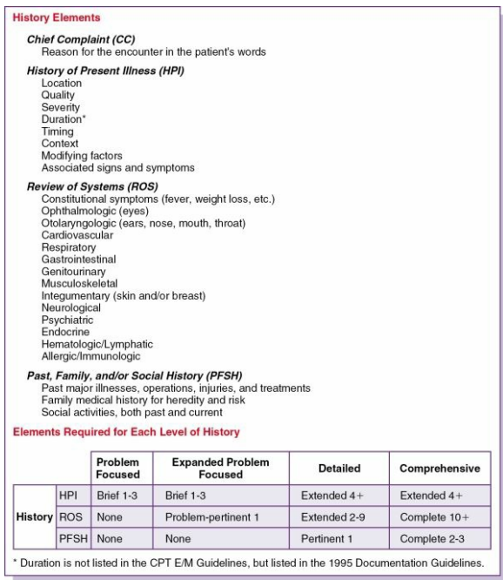

Slide 23
Examination
The patient has presented the physician with the subjective information regarding the complaint or problem in the history portion of the encounter; now the physician will do an examination of the patient to provide objective information, “hands-on” (those findings observed by the physician) about the complaint or problem. The physician then documents the objective findings in the patient record.

Slide 24
Examination
Examination levels.
The examination levels have the same titles as the history levels— problem focused, expanded problem focused, detailed, and comprehensive. The four levels are used to indicate the extent and complexity of the patient examination.
Examination levels
Problem focused
Expanded problem focused
Detailed
Comprehensive

Slide 25
Examination levels
Problem focused: Examination is limited to the affected body area or organ system identified by the chief complaint.
Expanded problem focused: A limited examination is made of the affected body area or organ system and other symptomatic or related body area(s)/organ system(s).
Detailed: An extended examination is made of the affected body area(s) and other symptomatic or related organ system(s).
Comprehensive: This is the most extensive examination; it encompasses a general multi-system examination and should include findings about 8 or more of the 12 organ systems.

Slide 26
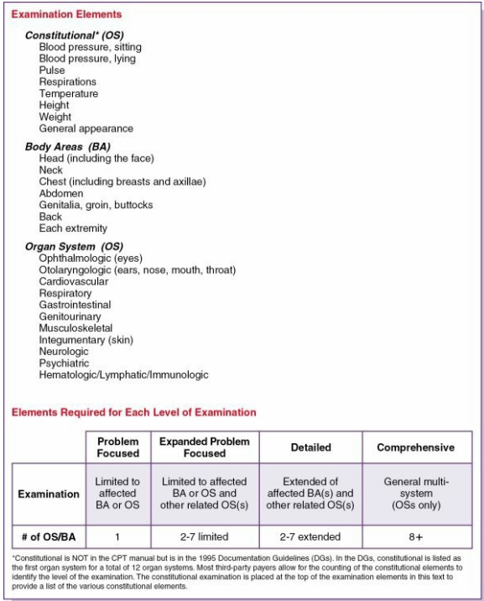

Slide 27
Levels of Medical decision making.
Medical decision-making complexity levels
Straightforward decision making: minimal diagnosis and management options, minimal or none for the amount and complexity of data to be reviewed, and minimal risk to the patient of complications or death if untreated.
Low-complexity decision making: limited number of diagnoses and management options, limited data to be reviewed, and low risk to the patient of complications or death if untreated.
Moderate-complexity decision making: multiple diagnoses and management options, moderate amount and complexity of data to be reviewed, and moderate risk to the patient of complications or death if untreated.
High-complexity decision making: extensive diagnoses and management options, extensive amount and complexity of data to be reviewed, and high risk to the patient for complications or death if the problem is untreated.

Slide 28
Medical decision making.
The key component of medical decision making (MDM) is based on the complexity of the decision the physician must make about the patient’s diagnosis and care. Complexity of decision making is based on three elements:
Number of diagnoses or management options. The options can be minimal, limited, multiple, or extensive.
Amount and/or complexity of data to review. The data can be minimal or none, limited, moderate, or extensive.
Risk of complication or death if the condition goes untreated. Risk can be minimal, low, moderate, or high.

Slide 29
Number of diagnoses or management options.
1. For each encounter, an assessment, clinical impression, or diagnosis should be documented. It may be explicitly stated or implied in documented decisions regarding management plans or further evaluation
For a presenting problem with an established diagnosis, the record should reflect whether the problem is (a) improved, well controlled, resolving, or resolved; or (b) inadequately controlled, worsening, or failing to change as expected.
For a presenting problem without an established diagnosis, the assessment or clinical impression may be stated in the form of differential diagnoses or as a “possible, ” “probable, ” or “rule out” (R/O) diagnosis.
Note: Physician/Provider coders do not code “rule out, ” “possible, ” or “probable” diagnosis; rather they code the presenting symptoms and/or complaints unless there is a definitive diagnosis rendered.

Slide 30
Number of diagnoses or management options.
2. The initiation of, or changes in, treatment should be documented. Treatment includes a wide range of management options, including patient instructions, nursing instructions, therapies, and medications.
3. If referrals are made, consultations requested, or advice sought, the record should indicate to whom or where the referral or consultation has been made or from whom the advice is requested.

Slide 31
Data to be reviewed. The following are some basic documentation guidelines for the amount and complexity of data to be reviewed:
If a diagnostic service (test or procedure) is ordered, planned, scheduled, or performed at the time of the E/M encounter, the type of service (e.g., laboratory or radiology) should be documented.
The review of laboratory, radiology, or other diagnostic tests should be documented. An entry in a progress note such as “WBC elevated” or “chest x-ray negative” is acceptable. Alternatively, the review may be documented by initialing and dating the report containing the test results.

Slide 32
Risk Some basic documentation guidelines for risk of significant complications, morbidity, or mortality include the following:
Comorbidities (secondary conditions), underlying diseases, or other factors that increase the complexity of medical decision making by increasing the risk of complications, morbidity, or mortality should be documented.
If a surgical or invasive diagnostic procedure is ordered, planned, or scheduled at the time of the E/M encounter, the type of procedure (e.g., laparoscopy) should be documented.
If a surgical or invasive diagnostic procedure is performed at the time of the E/M encounter, the specific procedure should be documented.
The referral for or decision to perform a surgical or invasive diagnostic procedure on an urgent basis should be documented or implied.

Slide 33
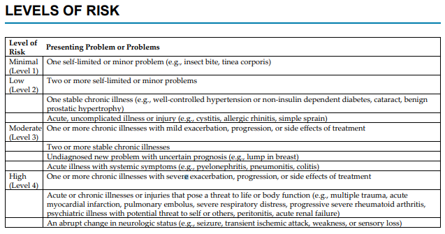

Slide 34
Risk Some basic documentation guidelines for risk of significant complications, morbidity, or mortality include the following:
Comorbidities (secondary conditions), underlying diseases, or other factors that increase the complexity of medical decision making by increasing the risk of complications, morbidity, or mortality should be documented.
If a surgical or invasive diagnostic procedure is ordered, planned, or scheduled at the time of the E/M encounter, the type of procedure (e.g., laparoscopy) should be documented.
If a surgical or invasive diagnostic procedure is performed at the time of the E/M encounter, the specific procedure should be documented.
The referral for or decision to perform a surgical or invasive diagnostic procedure on an urgent basis should be documented or implied.

Slide 35
medical decision making
When you select one of the four types of complexity of medical decision making:
Straightforward, low, moderate, or high—the documentation in the medical record must support the selection in terms of the number of diagnoses or management options, amount and/or complexity of data to be reviewed, and risks
Two of the three elements in Fig. below must be met or exceeded to qualify for a level of medical decision making.

Slide 36
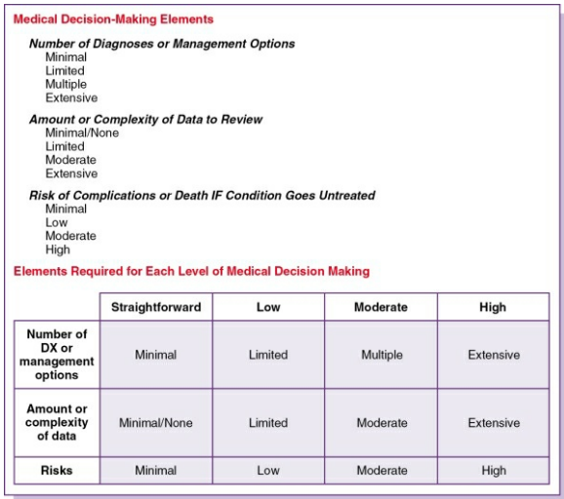

Slide 37
Nature of the presenting problem
This is the foundation of the level assigned. The presenting problem is the patient’s chief complaint or the situation that leads the physician to determining the level of care necessary to diagnose and treat the patient.
The CPT describes the presenting problem as a disease, condition, illness, injury, symptom, sign, finding, complaint, or other reason for the encounter, with or without a diagnosis being established at the time of the encounter.
There are five types of presenting problems:
■ Minimal ■ Self-limited ■ Low severity ■ Moderate severity ■ High severity

Slide 38
types of presenting problems:
Minimal: A problem may not require the presence of the physician, but a service is provided under the physician’s supervision. A minimal problem is a blood pressure reading, a dressing change, or another service that can be performed without the physician being immediately present.
Self-limited: Also called a minor presenting problem, a self-limited problem runs a definite and prescribed course, is transient (it comes and goes), and is not likely to permanently alter health status, or the presenting problem has a good prognosis with management and compliance.
Low severity: The risk of complete sickness (morbidity) without treatment is low, there is little or no risk of death without treatment, and full recovery without impairment is expected.

Slide 39
types of presenting problems:
4. Moderate severity: The risk of complete sickness (morbidity) without treatment is moderate, there is moderate risk of death without treatment, and an uncertain prognosis or increased probability of impairment exists.
5. High severity: The risk of complete sickness (morbidity) without treatment is high to extreme, there is a moderate to high risk of death without treatment, or there is a strong probability of severe, prolonged functional impairment.

